Slide 1

What Is Change and How Do Managers Deal with It?
Organizational Change is a reality of life. Managers, at one point or another, will have to make substantial changes.
  Any alteration of an organization’s people, structure, or technology
  cause stress and counter resistance in the workplace

Slide 2
What External Forces Create a Need to Change?
Both external and internal forces constrain managers, and bring about the need for change
The external forces that create the need for organizational change come from sources
  Marketplace
  Newly emerging technology
  Government laws and regulations
  Economy
  Labor markets..

Slide 3
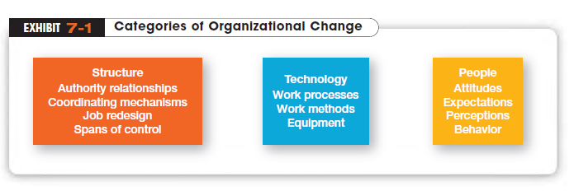
Notes:
Changing structure includes any alteration in authority relationships, coordination mechanisms, degree of centralization, job design, or similar organization structure variables.
Changing technology encompasses modifications in the way work is done or the methods and equipment used
Changes in people refer to changes in employee attitudes, expectations, perceptions, or behaviors

Slide 4
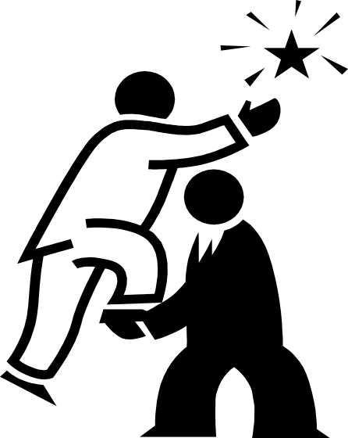
Who Initiates Organizational (Planned) Change?
Organizational changes need a catalyst.
Change Agents
  People who act as change catalysts and assume the responsibility for managing the change process

Slide 5
Change Metaphors
Until recently, the “Calm Waters” metaphor of change dominated the thinking of practicing managers and academics.
  Likens organizational change to a large ship making a predictable trip across a calm sea and experiencing an occasional storm
The prevailing model for handling change in such circumstances ideas, and knowledge is best illustrated in Kurt Lewin’s three-step description of the change process.

Slide 6
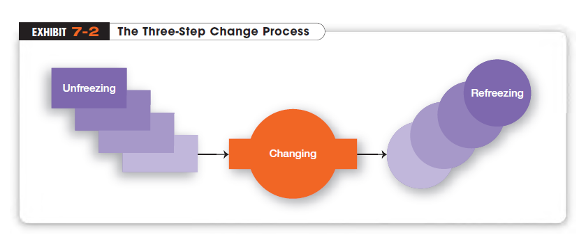
Kurt Lewin’s a contribution was about the dynamics of group decision making and changes are more readily accepted when people felt that they had an opportunity to be involved than they were simply asked or told to change.

Slide 7
From the Past to the Present
“If you want truly to understand something, try to change it.” Kurt Lewin, who’s often called the father of modern social psychology, made his name in management circles through his studies of group dynamics. His approach was based on the belief that “group behavior is an intricate set of symbolic interactions and forces that not only affect group structure but also modify individual behavior.”
Do you like to participate in decision-making? Why or why not?
Lewin’s findings suggested that changes would be more readily accepted when people felt they had an opportunity to be involved in the change rather than when they were simply asked or told to change. One of his research studies found that “changes were more easily induced through group decision making than through lectures and individual appeals.” Another of his major contributions was the idea of force field analysis, a framework for looking at the factors (forces) that influenced a situation.
What implications does Lewin's research have for today's managers?
Notes:
(a discipline that uses scientific methods to “understand and explain how the thought, feeling, and behavior of individuals are influenced by the actual, imagined, or implied presence of other human beings”)

Slide 8
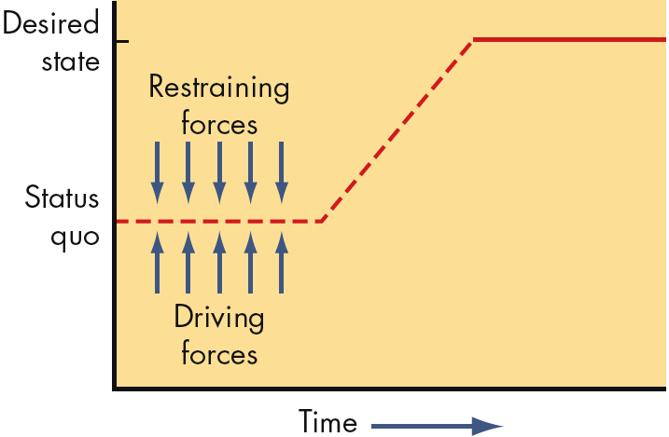
Force Field Analysis (Lewin)
Driving Forces
    Forces that direct behavior away from the status quo
    increasing pay, liberal moving expenses
Restraining Forces
    Forces that hinder movement from the existing equilibrium cab be decreased
    individual counseling to reduce fear

Slide 9
Change Starts a Chain of Events
An oil company’s headquarters in North-West US decides to consolidate divisional offices in South-East into a single regional office.
The reorganization meant transferring more than 150 employees, eliminating some duplicate managerial positions, instituting new hierarchy of command.
The people affected had no say whatsoever, but were expected to move to another city, pulling youngsters out of school, making new friends, having new coworkers, undergoing reassignment of responsibilities.
The only alternative course was to resign; fewer than 10% did!

Slide 10

More recently..
“White-Water Rapids” metaphor of change
  Likens organizational change to a small raft navigating a raging river
  and travelling at night !
  White-water metaphor is consistent with a world that’s increasingly dominated by information, ideas and knowledge.
  In this era, change has to be perceived as a natural state and managing change is a continual process.

Slide 11
How Do Organizations Implement Planned Changes?
Whatever happens—in terms of structure or technology—ultimately affects organizational members.
Organization Development (OD)
  Efforts to assist organizational members with a planned change by focusing on their attitudes and values
  Popular OD efforts in organizations rely heavily on group interactions and cooperation
Notes:
Often managers make a concerted effort to alter some aspect of the organization.

Slide 12
Organizational Development Activities
Survey feedback
  A method of assessing employees’ attitudes toward and perceptions of a change
  how they view decision making, leadership, communication effectiveness, satisfaction, etc.
Process Consultation
  Using outside consultants to assess organizational processes such as workflow, informal intra-unit relationships, and formal communication channels

Slide 13
OD Activities (cont.)
Team-Building
  Using activities to help work groups set goals, develop positive interpersonal relationships, and clarify the roles and responsibilities of each team member → group become more cohesive
Intergroup Development
  Activities that attempt to make several work groups more cohesive
  attempts to change attitudes, stereotypes, and perceptions that a group may have toward another

Slide 14
Sensitivity Training
  Training groups (T-groups) that seek to change behavior through unstructured group interaction
  Provides increased awareness of others and self
  Increases empathy with others, listening skills, openness, and tolerance for others

Slide 15
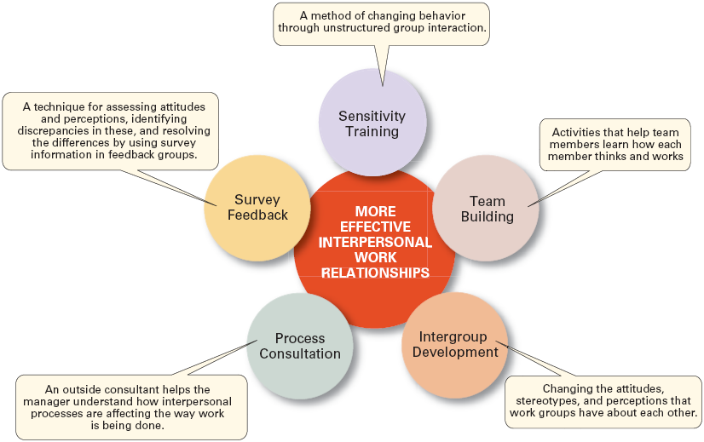
Popular OD Techniques

Slide 16
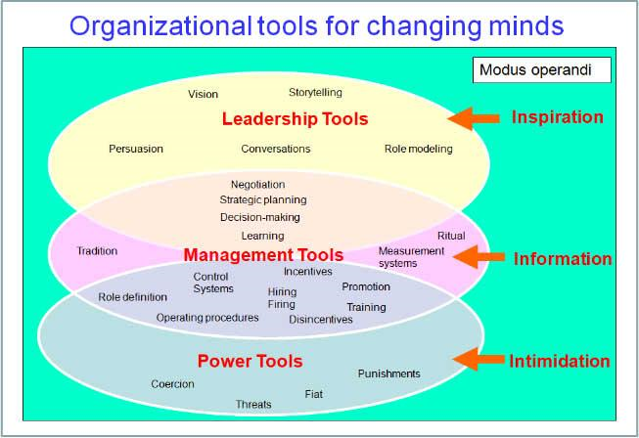
Notes:
Fiat: Order

